Slide 1
BANA-277 Final Project: Social Network Analysis
Group 9B: Matthias Ronnau, Lokesh Nandni Sood, Lu Wang, Yifan Wu, Bowen Yang

Slide 2
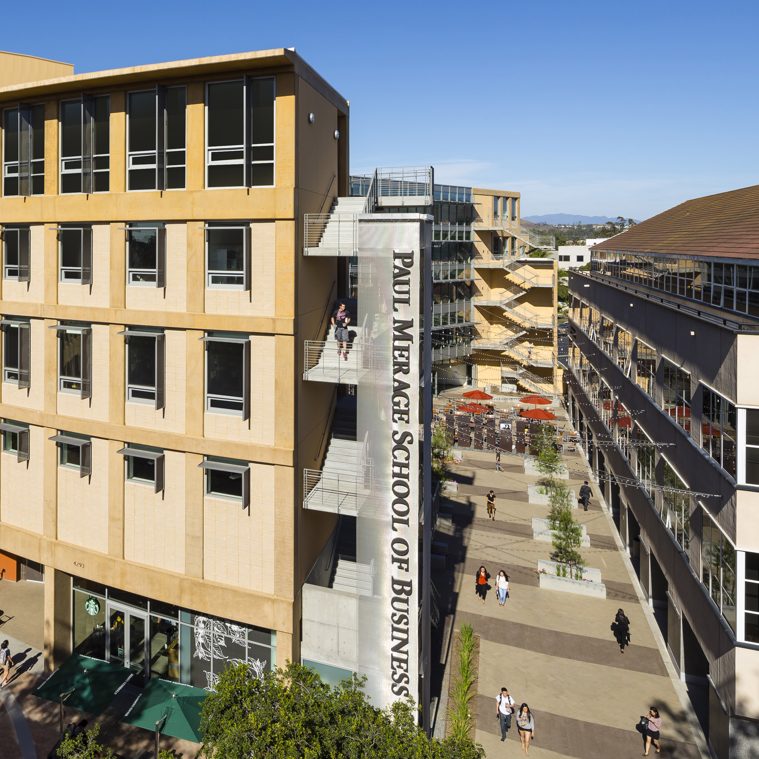
Agenda
Project Overview
The Data
Analysis
Results

Slide 3
Project Overview

Slide 4

Market Overview
Online shopping has increased significantly in recent years, with industry giants like Amazon generating billions of dollars annually
Coronavirus has pushed more people to shop online

Slide 5
Project Overview
Create a social network to understand the dynamics of what products are purchased together
Analyze various statistics of the network (hub/authority score, etc.)
Construct a logistic regression to understand what factors are most important in determining a purchase

Slide 6
Project Roadmap
Initial Question
Data Wrangling
Put data into graph format
Analysis
Generate subcomponent
Results
Logistic regression
Important factors determining purchase?
Prominent features of purchases
Transform variables
What types of products are purchased together?
What propels someone to make a purchase?

Slide 7
The Data

Slide 8

The Data
Sourced from Kaggle
Contains event information for a multi-category store (view, cart, and purchase) along with the type of product and its cost
9 columns and over 66,000,000 rows

Slide 9

Data Cleaning
For our network analysis we used non-missing purchase data
Developed an R package called “graphdata” that takes in a dataframe in unorganized event format and transforms it into an iGraph object to be used for network analysis
Obtained subcomponent based on the nodes’ degree

Slide 10
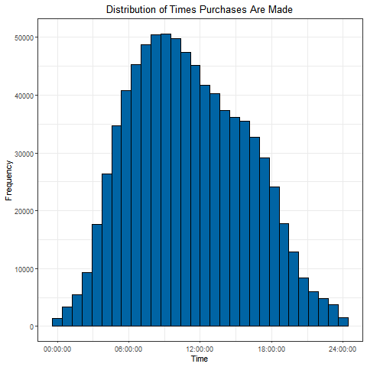
Exploratory Data Analysis
The distribution of times that people make purchases is roughly normal
Mean purchase time of 11:05 AM UTC
Store likely has many users around the world

Slide 11
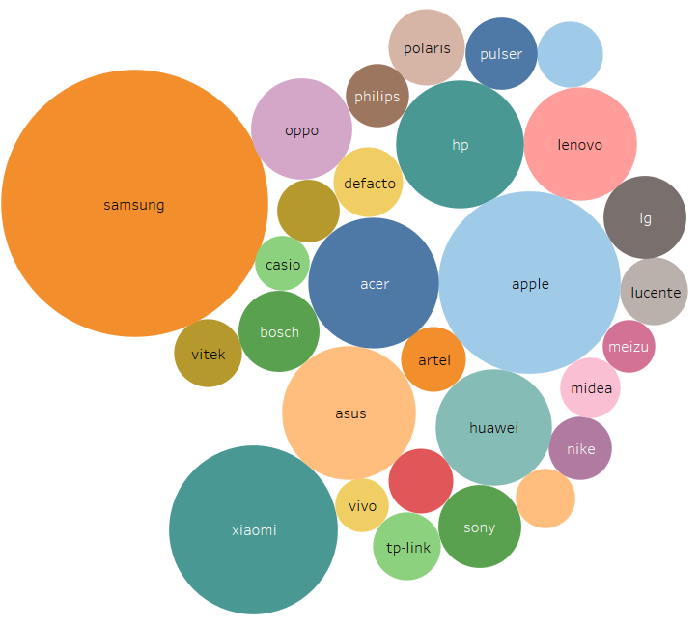
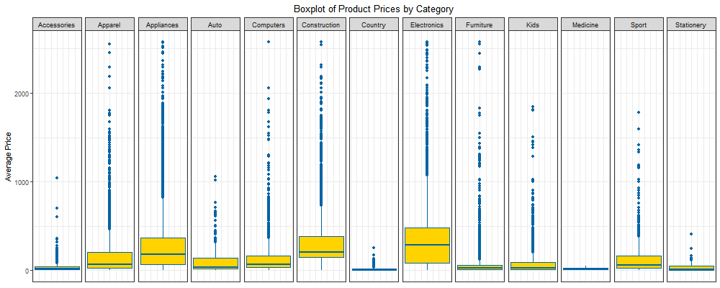
Exploratory Data Analysis, Cont.
Electronics are big amongst consumers yet have the highest prices of all segments

Slide 12
Analysis

Slide 13
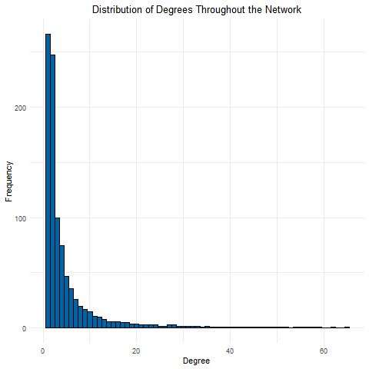
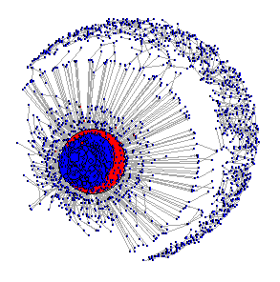
Social Network
Lots of items had a relatively small amount of connections, but the distribution was very right skewed
Max degree was 11,452
A few central products with lots of peripheral items
Edge density of 0.000253
Reciprocity of 0.387
Most purchased product was Samsung construction lights

Slide 14
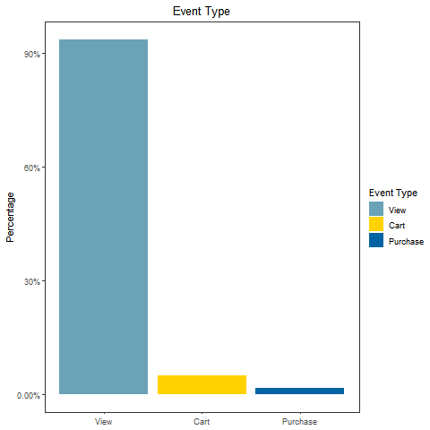
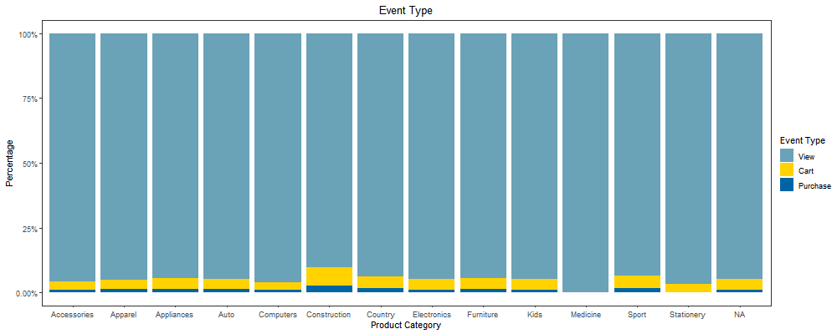
Logistic Regression
Construct logistic regression to predict probability of purchase using network statistics such as hub score, authority score
Calculate neighbor stats, such as the average percent of a time their neighbors were viewed, placed in a cart, or purchased

Slide 15
Results

Slide 16

Results and Further Exploration
Top categories purchased are electronics, appliances, and construction equipment
Very small conversion rate, target these categories at peak times of the data
Oversample purchases to get better estimates for logistic regression
Analyze effect of day of the week on odds of purchase
Tie in customer demographic data for better insights on what drives purchases

Slide 17

Thank You!

